Slide 1

DEPARTMENT OF ARTIFICIAL INTELLIGENCE AND DATA SCIENCE
Project Review
“ IMAGE CLASSIFICATION-BASED RANSOMWARE ATTACK DETECTION USING A DEEP-LEARNING ALGORITHM ”
Project Team Members
Name USN
P N PAVITHRA 1SJ22AD031
SHIRISHA C 1SJ22AD042
VARSHA S V 1SJ22AD057
Project Guide
Ms. Sandhya R
Assistant Professor

Slide 2

TABLE OF CONTENTS
Abstract
Purpose
Scope
Problem Statement
Introduction
Objectives
Literature Survey
Existing system
Proposed system
System Requirement and Specifications
Design and Architecture
Methodology
Modules split up
Implementation
Testing
screenshots of output
Conclusion
Future Enhancement
References
Dept of AI&DS, SJCIT
2025-26
2

Slide 3

ABSTRACT
Ransomware is a significant cybersecurity threat that encrypts data and disrupts systems, making early detection vital. The project introduces an automated ransomware detection system that utilizes Convolutional Neural Networks (CNNs) to analyze executable files as grayscale images. Built with PyTorch, it provides predictions via a Flask web API linked to a MySQL database. At the same time, additional features ensure secure detection without executing files.

Slide 4

PURPOSE
A fully automated, intelligent ransomware detection system is proposed for identifying malicious executable files through static analysis. By leveraging a Convolutional Neural Network (CNN)–based deep learning approach that analyzes executable files and images, the system accurately detects ransomware without executing the files. This approach enhances detection reliability while minimizing human intervention, computational overhead, and system risk, making it suitable for real-time and large-scale cybersecurity applications.

Slide 5
SCOPE
An advanced cybersecurity framework is developed to enable automated detection of ransomware using static analysis of executable files. The solution covers the complete workflow, including executable file collection, binary-to-image conversion, feature learning through Convolutional Neural Networks (CNNs), and performance evaluation using standard metrics. The system is integrated into a deployable architecture comprising a Flask-based backend application, supporting real-time file scanning and monitoring. This framework ensures reliability, scalability, and practical applicability for enterprise systems, end-user devices, and large-scale cybersecurity environments.

Slide 6
PROBLEM STATEMENT
Ransomware attacks are increasing and can easily bypass traditional antivirus systems.
Attackers frequently modify ransomware code, making detection ineffective.
Users remain at high risk of data loss and system disruption due to undetected ransomware
Lack of real‑time alert systems that notify users instantly during ransomware detection.

Slide 7
INTRODUCTION
Ransomware is a highly destructive type of malware that leads to substantial financial losses and operational disruptions for individuals and organizations worldwide. Many attacks go undetected until after files are encrypted, complicating recovery efforts. Traditional detection methods often fail against new ransomware variants and may require executing suspicious files, introducing security risks. A safer approach is static analysis, but manual inspection of binary data is complex and time-consuming. By converting executable files into grayscale images, it's possible to extract meaningful patterns. Convolutional Neural Networks (CNNs) can learn these patterns, allowing them to differentiate between ransomware and legitimate software. The project proposes a CNN-based detection system that analyzes executables without execution, providing an efficient and accurate method for modern ransomware defense.

Slide 8
OBJECTIVES
Improve detection accuracy and robustness using diverse malware and benign datasets.
Enhance model generalization through regularization techniques such as dropout, data normalization, and adaptive learning rate optimization.
Enable automated ransomware detection without executing files to ensure system safety.
Reduce computational complexity and inference time to support real-time scanning and monitoring on web and desktop platforms.

Slide 9
LITERATURE SURVEY
Author(s) | Research Paper Title | Advantages | Disadvantages | Implementation in Project
Zhang et al. | Malware Detection Using Deep Convolutional Neural Networks | High detection accuracy using image-based malware representation | Computationally intensive; requires tuning | Justifies CNN-based ransomware image classification
Kolosnjaji et al. | Deep Learning for Classification of Malware System Call Sequences | Deep learning captures complex malware patterns; good detection accuracy | Requires dynamic execution; prone to sandbox evasion | Motivated static deep learning approach to avoid execution
Nataraj et al. | Malware Images: Visualization and Automatic Classification | Converts malware binaries into images; CNNs achieve high accuracy; avoids execution | Limited to static analysis; sensitive to dataset quality | Inspired binary-to-image conversion for ransomware detection
Sgandurra et al. | Automated Dynamic Analysis of Ransomware (EldeRan) | Early detection of ransomware behavior; effective against obfuscation | Requires sandbox execution; high computational cost | Highlights importance of ransomware-specific feature learning

Slide 10
EXISTING SYSTEM
Earlier ransomware detection systems used traditional machine learning techniques such as SVM and Random Forest with manually extracted features, requiring expert effort and extensive preprocessing. These approaches were slow and showed limited generalization to new ransomware variants, despite achieving moderate accuracy. Dynamic analysis methods improved detection but introduced high computational overhead and security risks. Deep learning approaches, particularly CNN-based malware image analysis, automated feature extraction, and improved accuracy, but still faced challenges in scalability and deployment efficiency.

Slide 11
PROPOSED SYSTEM
The proposed system is a CNN-based ransomware detection framework designed to classify executable files as ransomware or benign using static analysis. Raw binary data from executable files is directly converted into grayscale images, eliminating the need for manual feature extraction. A Convolutional Neural Network (CNN) learns visual and structural patterns present in ransomware binaries through multiple convolution and pooling layers. Dropout is applied to reduce overfitting, while fully connected dense layers refine the extracted features. A Softmax output layer performs final classification into ransomware and benign categories with confidence scores. This approach provides an accurate, automated, and efficient solution for ransomware detection without executing potentially malicious files.

Slide 12
SOFTWARE AND HARDWARE REQUIREMENTS
Sl. No | Software Requirements | Hardware Requirements
1 | Operating System: Windows 10 / 11 | System: Intel i5 or higher
2 | Coding Language: Python 3.9 / 3.10 | Processor: Minimum 4-core CPU
3 | Frontend Language: HTML5, CSS3, JavaScript (ES6+) | RAM: Minimum 8 GB
4 | Backend Framework: Flask | GPU: Optional (NVIDIA GPU with 4 GB VRAM recommended for training)
5 | Database: MySQL / SQLite | Storage: Minimum 50 GB free disk space
6 | Deep Learning Libraries: PyTorch, NumPy | Input Devices: Any modern computer with keyboard and mouse

Slide 13

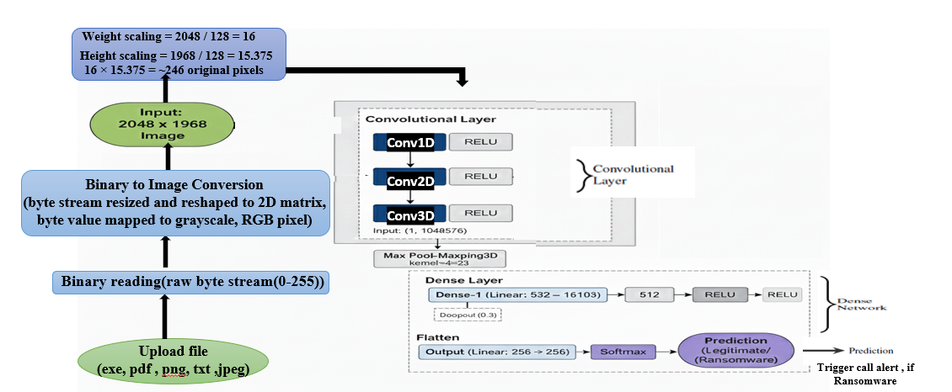
DESIGN AND ARCHITECTURE
Model Architecture

Slide 14
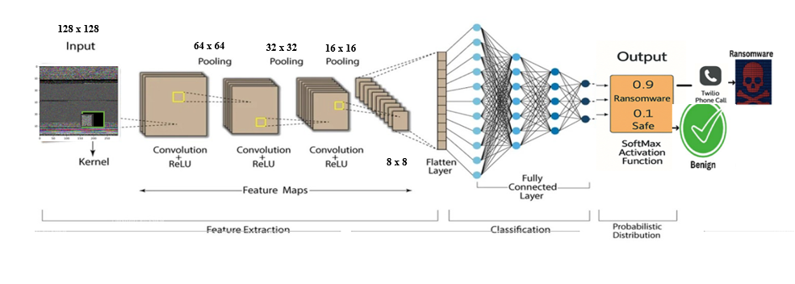
CNN ARCHITECTURE

Slide 15
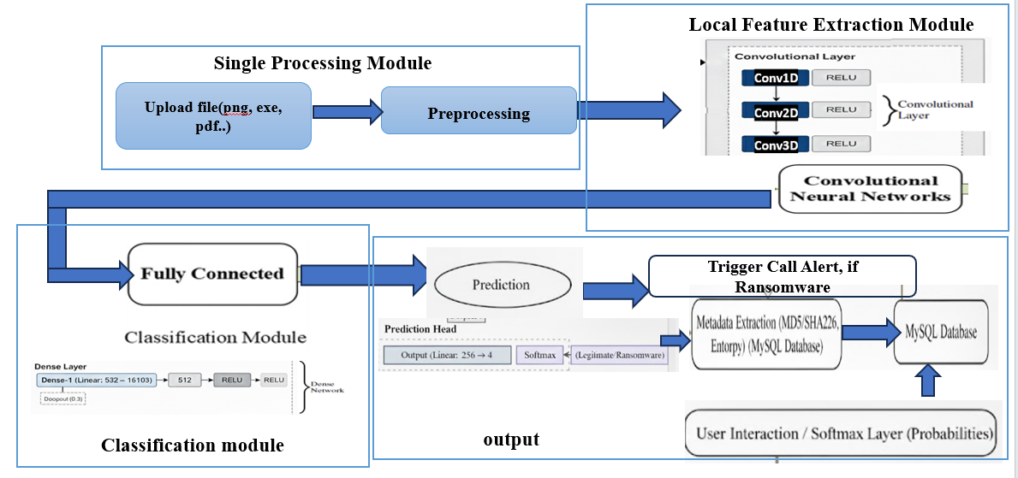
FLOW CHART

Slide 16
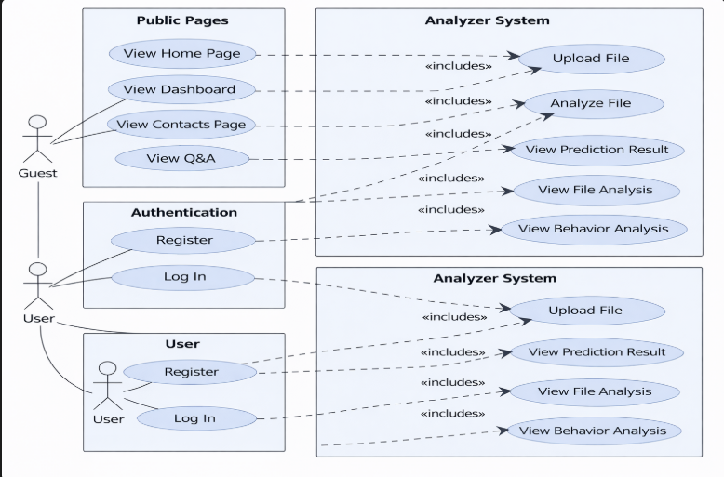
USE CASE DIAGRAM

Slide 17
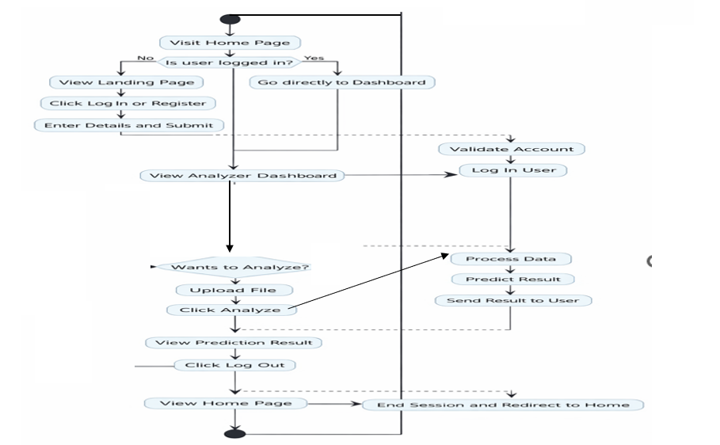
ACTIVITY DIAGRAM

Slide 18
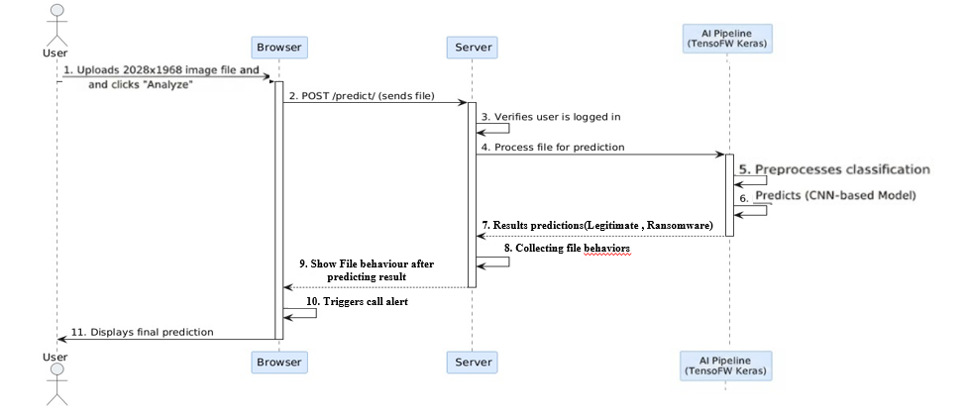
SEQUENCE DIAGRAM

Slide 19

METHODOLOGY
Data Collection: Collected ransomware executable samples from Malware-Bazaar, Virus-Total, and GitHub. Collected benign executable samples from Snap-Files, Portable-Apps, and GitHub.
2. Data Preprocessing: Read raw binary bytes from executable files using Python, convert byte streams into fixed-length sequences.
Reshaped 1D byte data into 2D matrices. Mapped matrices to grayscale images using byte-to-pixel intensity mapping.
Split the dataset into 80% training and 20% testing data with random shuffling.
3. Model Development: Designed a CNN-based deep learning model using PyTorch.
Used convolutional layers to extract visual patterns from malware images.
Applied ReLU activation and dropout for regularization.
Used dense layers for binary classification (Ransomware / Benign).
Generated prediction confidence using Softmax.
4. Deployment and Detection: Deployed the trained model using a Flask web API. Integrated MySQL database for user authentication and prediction history.

Slide 20
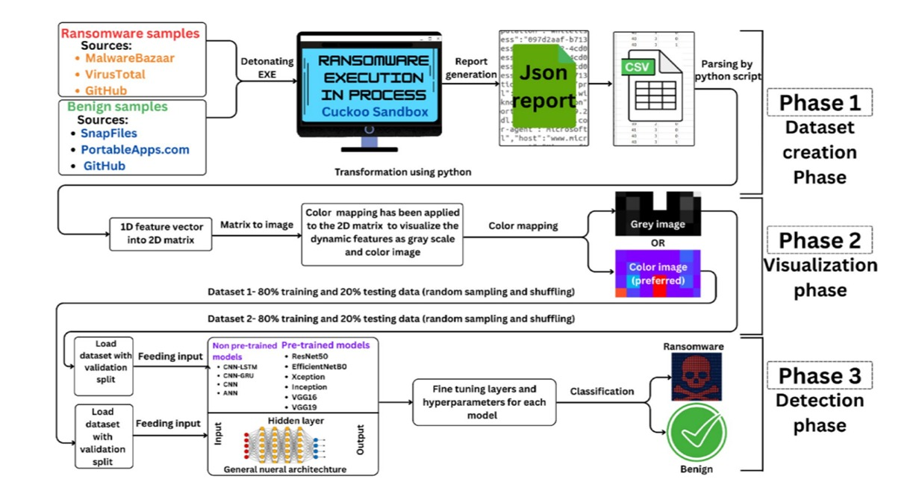
Proposed Methodology Architecture

Slide 21
MODULE SPLIT-UP
LIST OF MODULES
Data Collection & Preprocessing Module
CNN Model Training Module
Prediction & Analysis Module
Deployment & User Interface Module

Slide 22
Module 1: Data Collection & Preprocessing: Executable files are collected and transformed into a format suitable for deep learning analysis.
Purpose in the Model:
Collects ransomware and benign executable samples from trusted sources.
Reads raw binary data from executable files.
Converts byte streams into grayscale images using byte-to-pixel mapping.
Prepares standardized input data for CNN processing.
Module 2: CNN-Based Ransomware Detection: A Convolutional Neural Network is used to learn patterns from grayscale executable images.
Purpose in the Model:
Automatically extracts meaningful visual features from images.
Identifies ransomware-specific textures and structural patterns.
Classifies files as Ransomware or Benign with high accuracy.
Handles unknown and previously unseen ransomware variants.
Acts as the core intelligence of the system.

Slide 23
Module 3: Prediction & Analysis: The trained CNN model analyzes executable files and generates detection results.
Purpose in the Model:
Performs static analysis without executing files.
Produces prediction labels with confidence scores.
Extracts additional features such as file entropy and hashes.
Supports decision-making through detailed analysis output.
Module 4: Deployment & User Interface: The detection system is deployed through a web application.
Purpose in the Model:
Provides a Flask-based backend for model inference and API access.
Stores user data and prediction history using MySQL.
Offers a web interface for manual file scanning.
Uses the Twilio API to send voice call alerts when ransomware is detected.

Slide 24
IMPLEMENTATION
CNN (Convolutional neural network)
Input Layer: Takes an uploaded image (PNG/JPG/exe/pdf) and converts it into a standardized format (grayscale, resized to 128×128).
Convolution Layers: Extract key spatial features such as edges, texture patterns, and malicious artefacts present in ransomware-infected files.
Activation (ReLU): Highlights important patterns.
Pooling Layer: Reduces dimensionality or size while preserving essential feature patterns.
Fully Connected Layer: Converts extracted features into class scores:{Ransomware, Legitimate}.
Soft-max Probability: Produces final confidence score and class label.

Slide 25

2. Twilio Alert
Event Trigger: When the CNN classifier detects Ransomware.
Twilio Client Initialization: Uses secure credentials (ACCOUNT_SID, AUTH_TOKEN).
Alert Mechanism: Initiates an automated phone call to the registered user.
Voice Message: Plays a spoken alert: “Ransomware detected. Please take immediate action.“
Notification Delivery: User receives a real-time phone call alert for critical threat detection.

Slide 26
CNN Implementation
# Load image and preprocess
img = Image.open(io.BytesIO(file.read())).convert("L")
img = transform(img).unsqueeze(0).to(device)
# Predict using the DeepCNN model
with torch.no_grad():
output = model(img)
prob = torch.softmax(output, dim=1)[0]
pred = torch.argmax(prob).item()
# Final label
label = "Ransomware" if pred == 1 else "Legitimate"
Twilio Alert Implementation
# Twilio client
client = Client(ACCOUNT_SID, AUTH_TOKEN)
# Make alert call when ransomware is detected
def make_alert_call():
client.calls.create(twiml='<Response><Say>Alert! Ransomware detected.</Say></Response>', from_=TWILIO_NUMBER, to=USER_PHONE)
# Trigger alert
if label == "Ransomware":
make_alert_call()

Slide 27
TESTING
1. UNIT TESTING:
Test Name | Test Description | Input | Expected Output | Actual Output | Test Result
Image file validation | Validate supported image formats | .png, .jpg, .jpeg, .pdf, .exe | File accepted | File accepted | Pass
Image preprocessing Model prediction | Check resizing, grayscale conversion &normalization Validate Softmax probability output | Uploaded image Preprocessed tensor | Tensor(1x1x128x128) Two-class probability (Ransomware /Legitimate) | Correct tensor generated Correct probabilities returned | Pass Pass

Slide 28
2. INTEGRATED TESTING:
Test Name | Test Description | Input | Expected output | Actual output | Results
Full pipeline execution | Test upload-> preprocess -> predict flow | Normal image | Legitimate file | Legitimate file | Pass
Ransomware detection | Check if CNN detects malicious image | Ransomware image | Ransomware detected | Successfully detected | Pass
Alert function trigger | Validate Twilio call after detection | Prediction = ransomware | Phone call initiated | Call triggered successfully | Pass

Slide 29
3. SYSTEM TESTING:
Test name | Test Description | Input | Expected output | Actual output | Results
End –to-end workflow | Validate entire system performance | Image uploaded via web UI | Full workflow completes | Work correctly | Pass
Response time check | Measure system speed | Multiple test images | < 2 sec response time | 1.2-1.5 sec observed | Pass
Error handling | Validate behaviour for invalid inputs | .apk, .doc, corrupt image | “Invalid file format “ error | Error displayed correctly | Pass

Slide 30
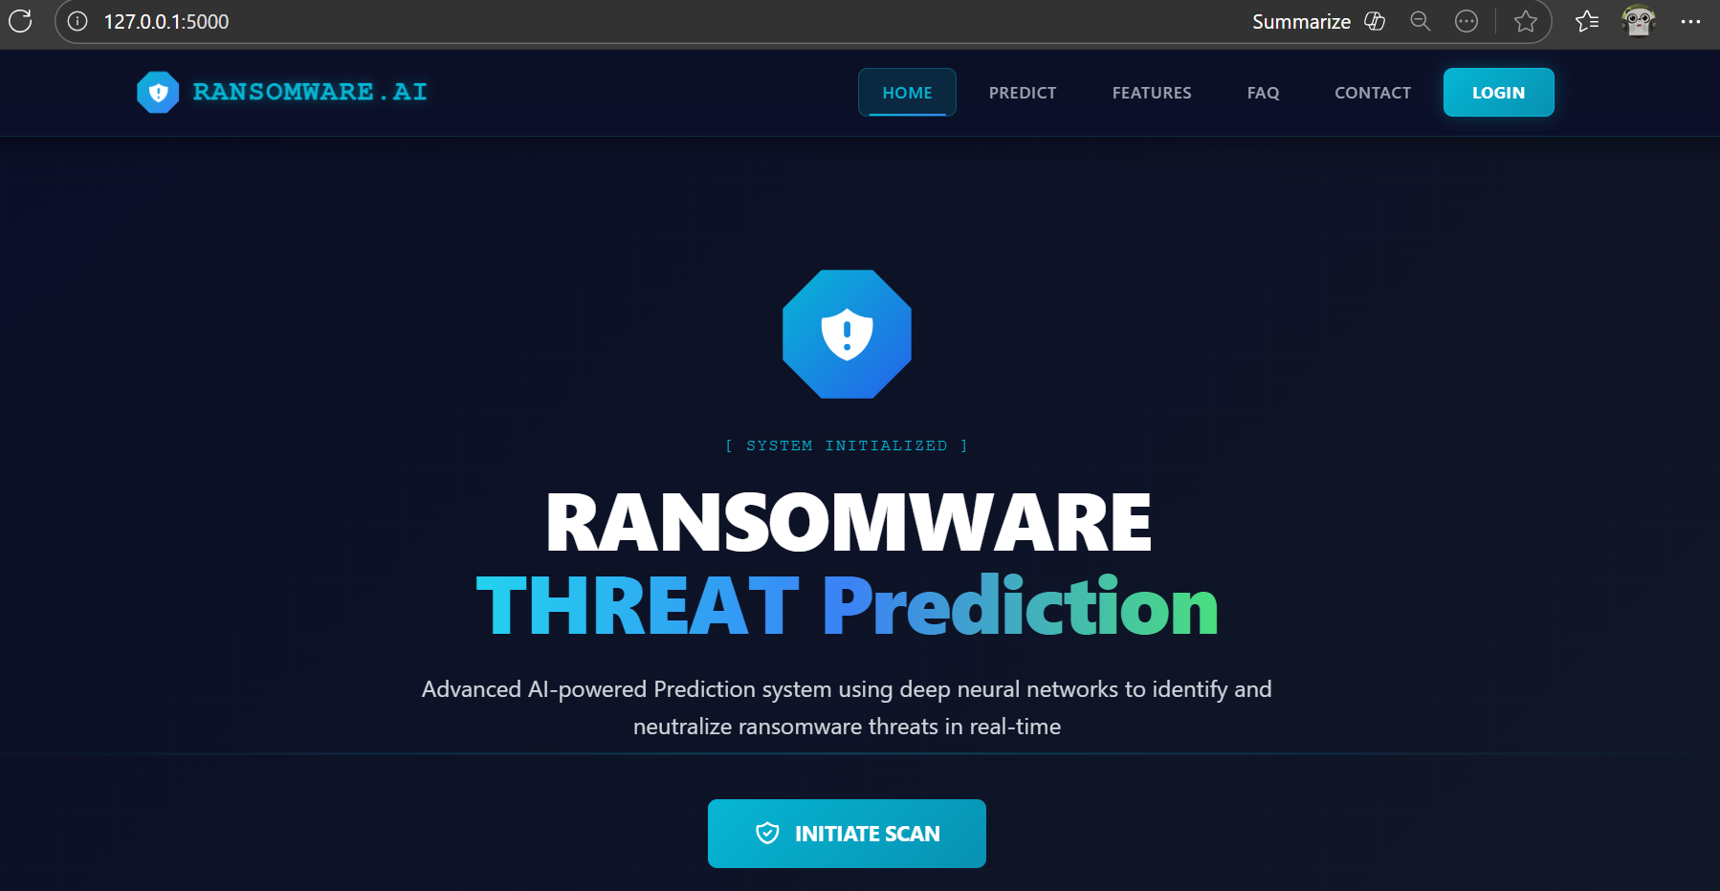
SCREENSHOTS OF OUTPUTS

Slide 31
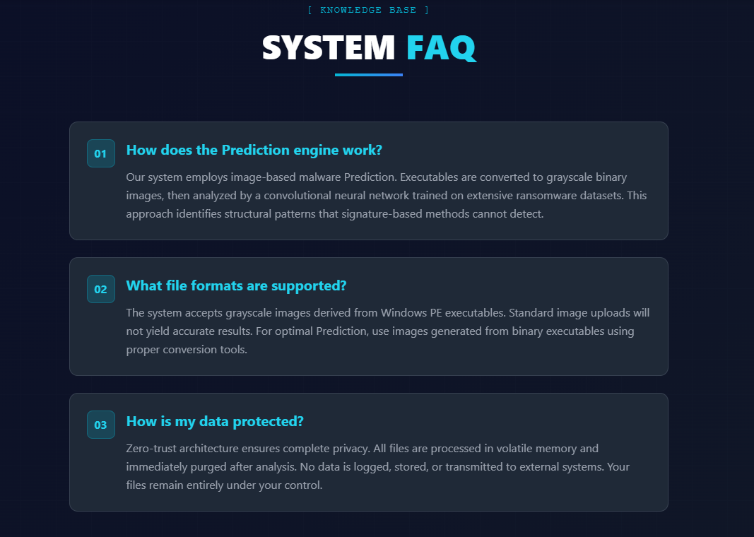
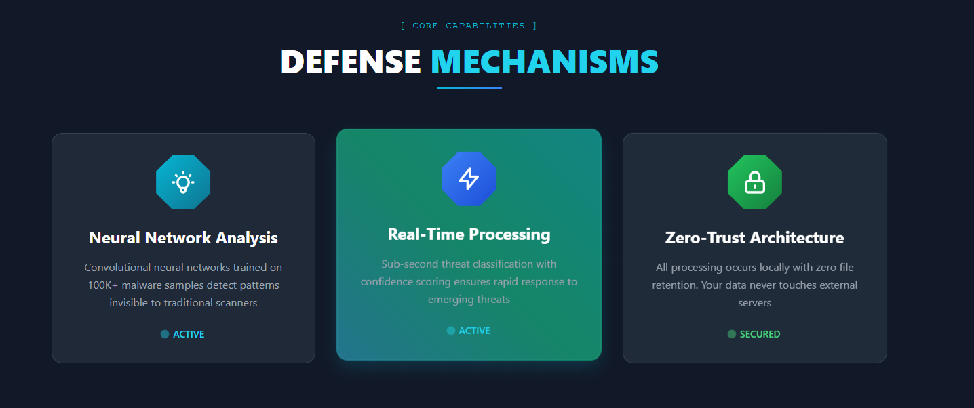
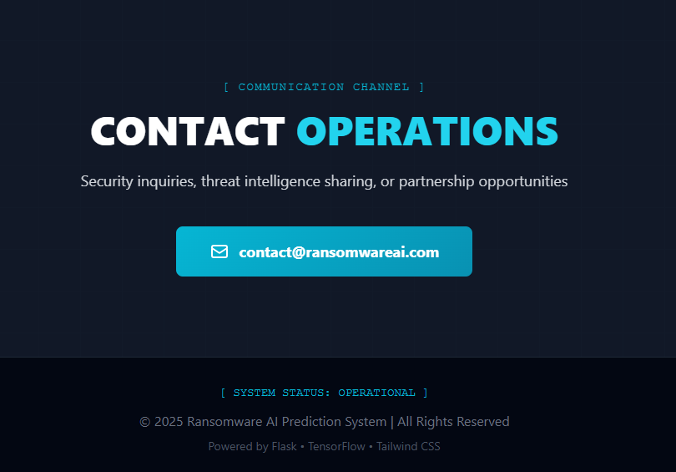

Slide 32
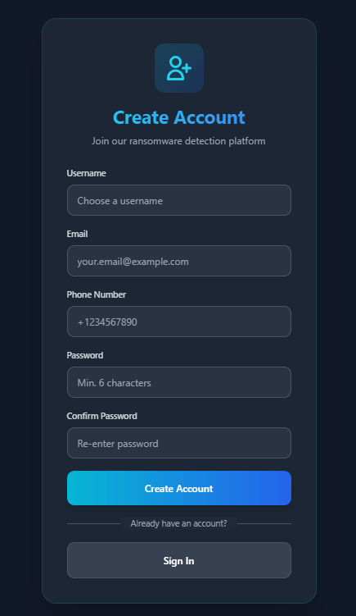
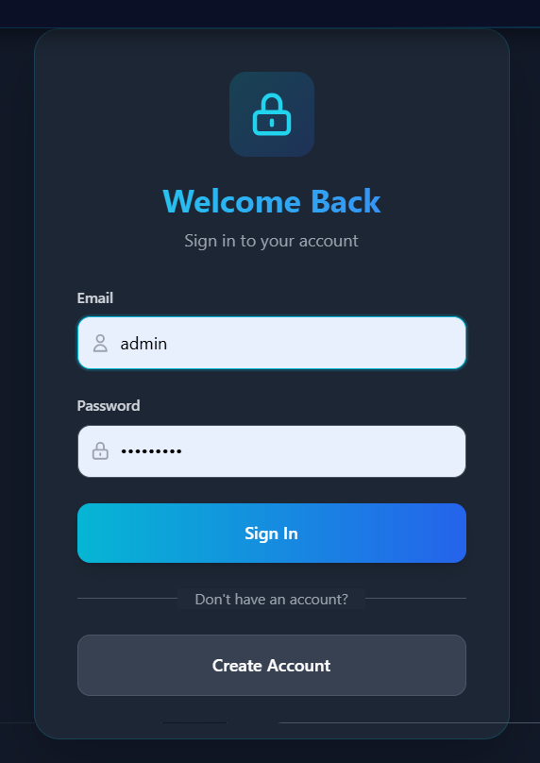

Slide 33
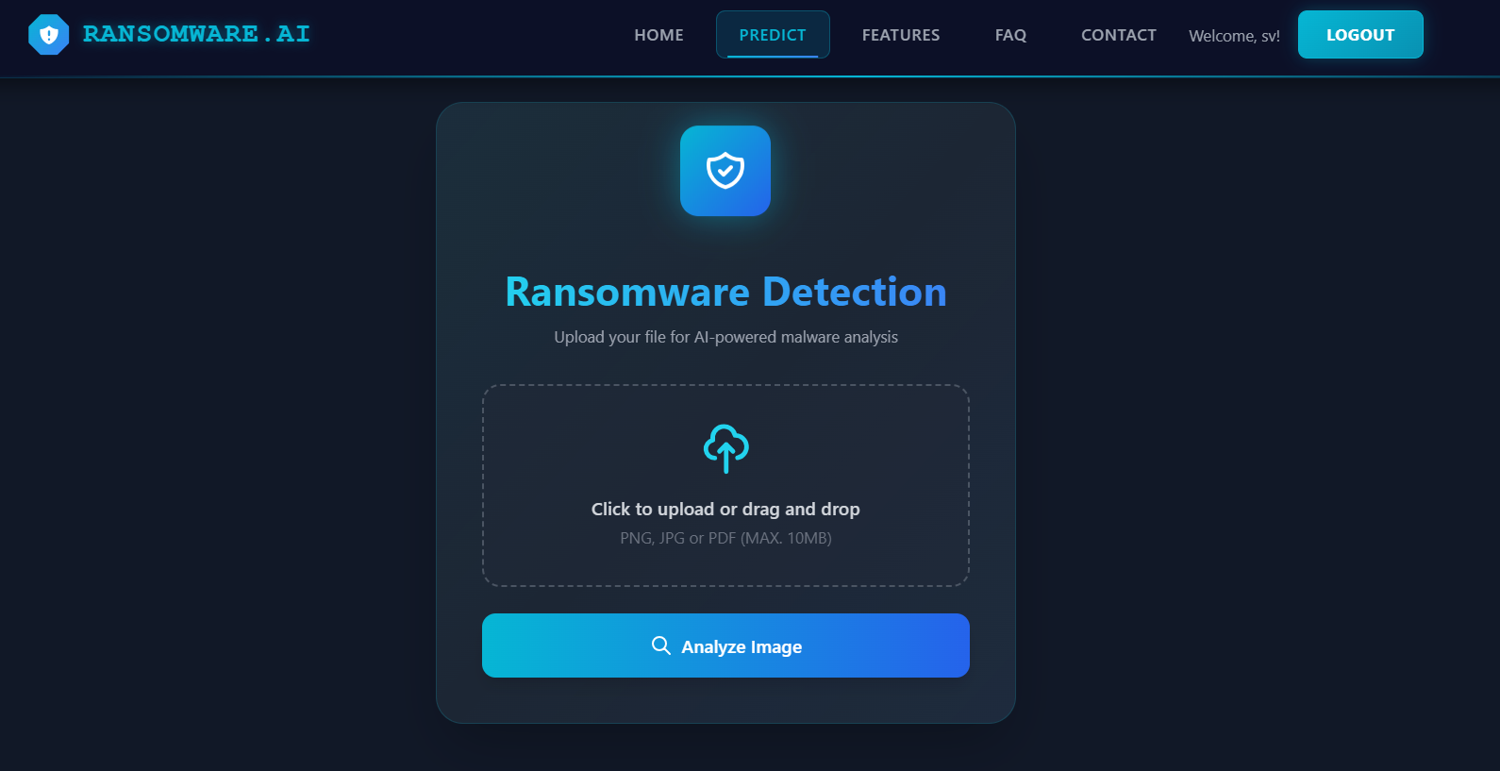

Slide 34
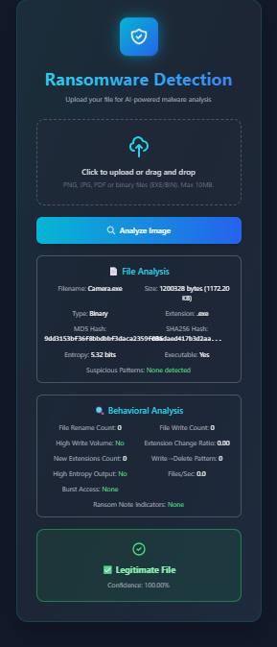
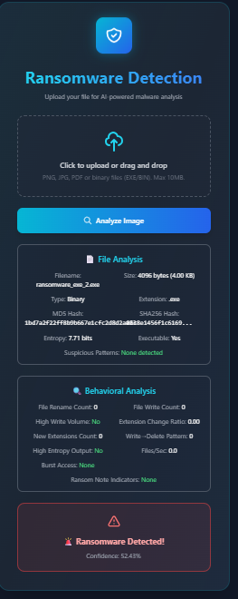
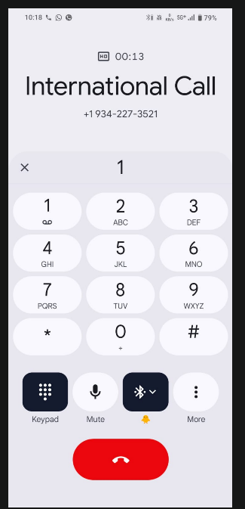

Slide 36
CONCLUSION
The project successfully detects ransomware with a CNN. The system gives fast and accurate results through a user-friendly web application. Real-time Call alerts make the system more reliable and useful for early warning. Overall, the project proves that deep learning can detect ransomware effectively before it causes damage.
FUTURE ENHANCEMENTS
Add support for more ransomware families to improve accuracy. Build a real-time monitoring system that scans files automatically without user upload. Create a desktop or mobile app version for easier use. Add cloud storage protection and automatic file isolation when a threat is detected. Improve alert features by sending email alerts and logging to the dashboard.

Slide 37
REFERENCES
Alraizza, A., & Algarni, A. (2023). Ransomware detection using machine learning: A survey. Big Data and Cognitive Computing, 7(3), 143.
Kok, S., Abdullah, A., Jhanjhi, N., & Supramaniam, M. (2019). Ransomware threat and detection techniques: A review. Int. J. Comput. Sci. Netw. Secur, 19(2), 136.
Musonda, M., Zimba, A., & Sinyinda, M. (2023). Machine learning-based crypto ransomware detection model on Windows platforms. ICICT-Zambia, 5(1), 141-147.
Ganfure, G. O., Wu, C.-F., Chang, Y.-H., & Shih, W.-K. (2022). Deepware: Imaging performance counters with deep learning to detect ransomware. IEEE Transactions on Computers, 72(3), 600-613.
Almomani, I., et al. (2021). Android ransomware detection using a hybrid evolutionary approach. IEEE Access, 9, 57674-57691.

